Slide 1

Communication System
IICT Lecture 10
FAST NUCES, Lahore

Slide 2
What is Communication?
exchanging of information by speaking, writing, or using some other medium.
FAST NUCES, Lahore
Notes:
Act of transferring information from one place to another

Slide 3
Characteristics of Communication System
There must be a Sender and Receiver
A protocol is a set of rules which governs the transfer of data between computers.
Protocols allow communication between computers and networks.
Handshaking is used to establish which protocols to use
Handshaking controls the flow of data between computers
Protocols will determine the speed of transmission, error checking method, size of bytes, and whether synchronous or asynchronous
FAST NUCES, Lahore

Slide 4
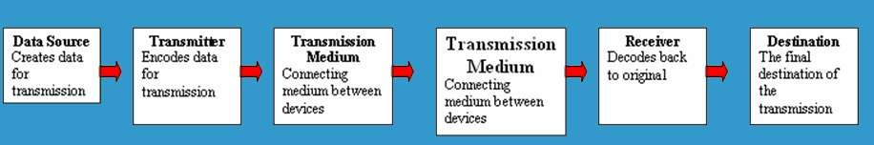
Five Basic Components
Every communication system has 5 basic requirements
Data Source (where the data originates)
Transmitter (device used to transmit data)
Transmission Medium (cables or non cable)
Receiver (device used to receive data)
Destination (where the data will be placed)
FAST NUCES, Lahore

Slide 5
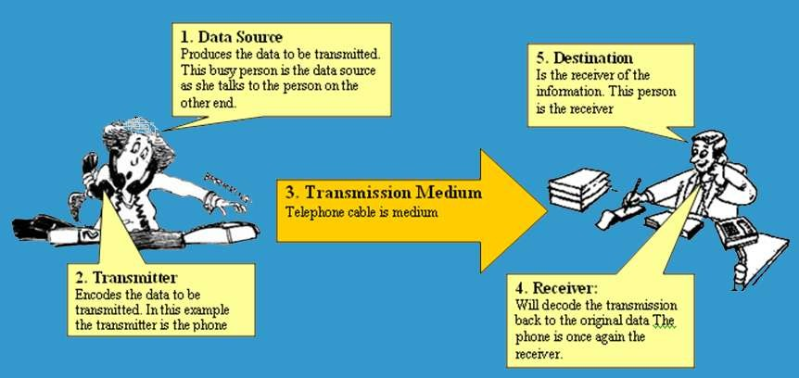

Pictorial Representation
FAST NUCES, Lahore

Slide 6
OSI Model
The Open Systems Interconnection model (OSI model) is a conceptual model that characterizes and standardizes the communication functions of a telecommunication or computing system without regard to its underlying internal structure and technology.
The OSI model also provides much more information which is included with each package.
FAST NUCES, Lahore

Slide 7
7 Layers of OSI Model
OSI “Open System Interconnection”
OSI is not a protocol but a list of protocols divided between 7 layers with each layer having a different set of functions.
Each packet is layered/packaged with protocols from each of the layers as it is processed.
The process of layering the protocols around each package is called encapsulation. The final encapsulated data packet is called a frame.
FAST NUCES, Lahore

Slide 8
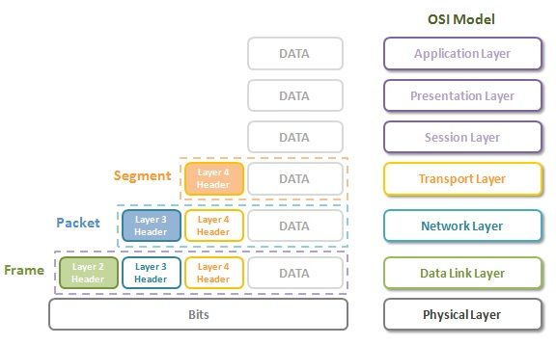
OSI Model
FAST NUCES, Lahore

Slide 9
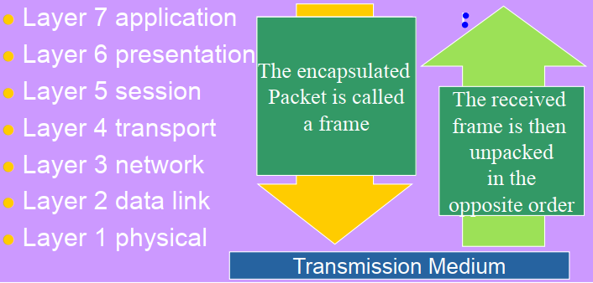
OSI Model
OSI Reference Model
FAST NUCES, Lahore

Slide 10
Service Performed at Each Layer
Layer 7: the application layer (generates data – interface )
  provides access to available network resources (format data for lower layers)
Layer 6: the presentation layer
  translates, encrypts, and compresses data
Layer 5: the session layer
  Establishes/terminates connection, manages, and terminates communicative sessions
Layer 4: the transport layer (how much data, at what rate)
  provides reliable process-to-process message delivery and error checking
Layer 3: the network layer
  moves packets from source to destination providing internetworking capabilities
Layer 2: the data link layer
  Control the flow of data – deal with transmission errors
Layer 1: the physical layer
  transmits bits over a medium establishing mechanical and electrical specifications
FAST NUCES, Lahore

Slide 11
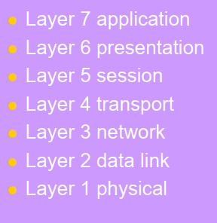
Service Performed at Each Layer
E-mail, Web browser, Directory
POP, SMTP, FTP, HTTP, DNS
Sockets
TCP
IP
PPP, Ethernet, Token ring
100baseT
FAST NUCES, Lahore

Slide 12
Transmitting and Receiving in Comm. Systems
FAST NUCES, Lahore

Slide 13

Serial Transmission
Data is transmitted, on a single channel, one bit at a time one after another
Much faster than parallel because of way bits processed (e.g. USB and SATA drives)
FAST NUCES, Lahore

Slide 14
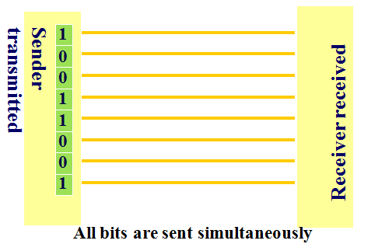
Parallel Transmission
Each bit has it’s own piece of wire along which it travels
Often used to send data to a printer
FAST NUCES, Lahore

Slide 15
Why not to use Parallel instead Serial?
Due to inconsistencies on channels data arrives at different times
Because of the way it is transmitted packet switching cannot be used
The above two points makes parallel slower than serial and requires higher bandwidth.
Parallel transmissions are rarely used anymore
FAST NUCES, Lahore

Slide 16
Synchronous VS Asynchronous Transmission
Synchronous Transmission
All data sent at once and no packet switching (instant messaging, video conferencing)
Asynchronous Transmission (Telephone line)
most common type of serial data transfer
Allows packet switching
Allows sharing of bandwidth (i.e. talk on phone while another person is using internet)
FAST NUCES, Lahore

Slide 17
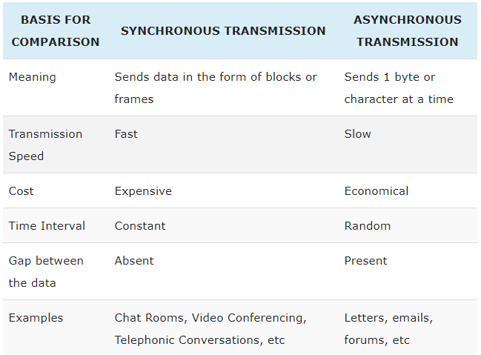
Synchronous VS Asynchronous Transmission
FAST NUCES, Lahore

Slide 18
Transmission Directions
Simplex: One direction only
Half duplex: Both directions but only one
direction at a time
Full duplex: send and receive both directions at once
FAST NUCES, Lahore

Slide 19
Network Topologies
Mesh Topology
Ring Topology
Bus Topology
Star Topology
FAST NUCES, Lahore

Slide 20
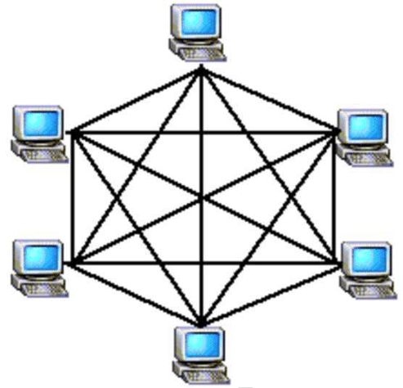
Mesh Topology
FAST NUCES, Lahore

Slide 21
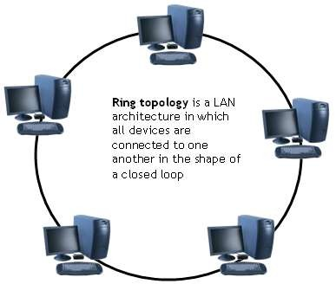
Ring Topology
FAST NUCES, Lahore

Slide 22
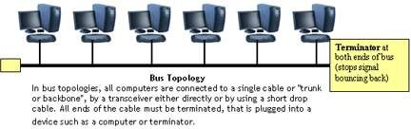
Bus Topology
FAST NUCES, Lahore

Slide 23
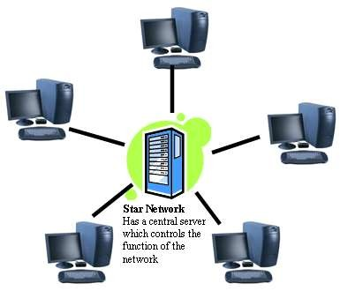
Star Topology
FAST NUCES, Lahore

Slide 24
Network Hardware
FAST NUCES, Lahore

Slide 25
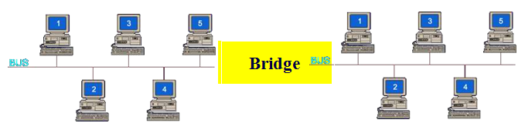
Bridge
Large networks can be separated into two or more smaller networks using a bridge. This is done to increase speed and efficiency. This type of network is called a segmented LAN and has largely been superseded by the use of switches which can transfer data straight to a computer and thus avoid bottleneck jams which bridges were designed to fix.
FAST NUCES, Lahore

Slide 26
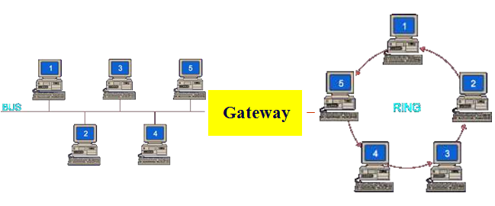
Gateway
passage to connect two networks together that may work upon different networking models
Often used to connect a LAN with a WAN.
Gateways join two or More different networks together.
FAST NUCES, Lahore

Slide 27
Some more
Routers: A router is a networking device that forwards data packets between computer networks. Can be used in place of a switch or bridge.
Switches: smart hubs which transmit packets to the
destination port only
Hubs: like double adapters /power boards in the home
except instead of plugging in extension cords we are plugging
in computers to allow them to communicate.
FAST NUCES, Lahore

Slide 28
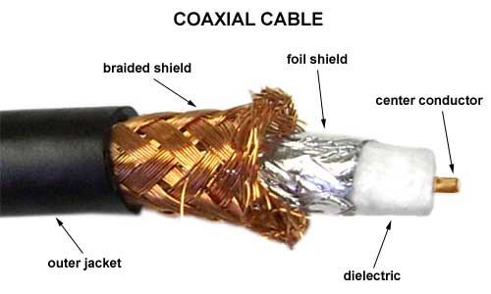
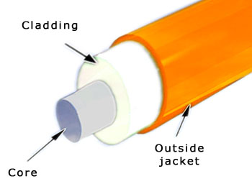
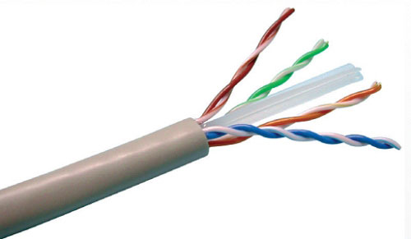
Transmission Media
Twisted pair – Ethernet cable
Coaxial cable –Thick black cable used for higher bandwidth communications than twisted pair (i.e. Optus cable)
Fiber optic – data transferred through pulses of light. Extremely fast.
Non cable methods such as satellite, microwave, wireless and Bluetooth
FAST NUCES, Lahore

Slide 29
End of the Lecture
FAST NUCES, Lahore

